Slide 1

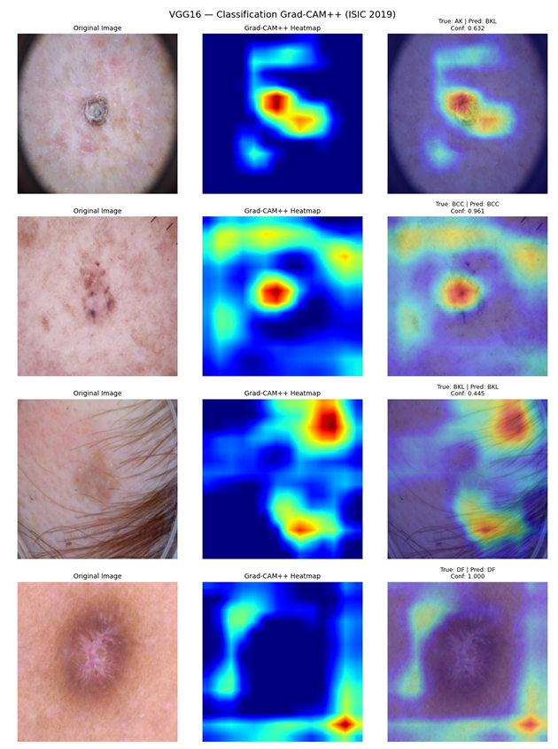
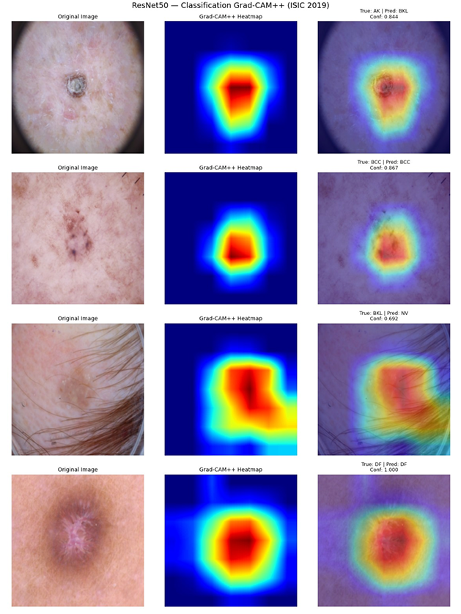
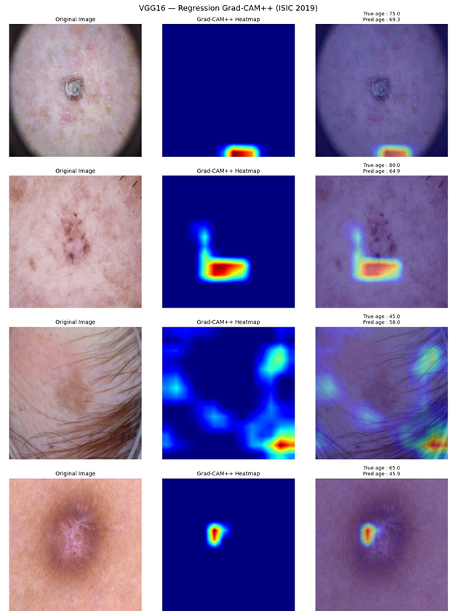
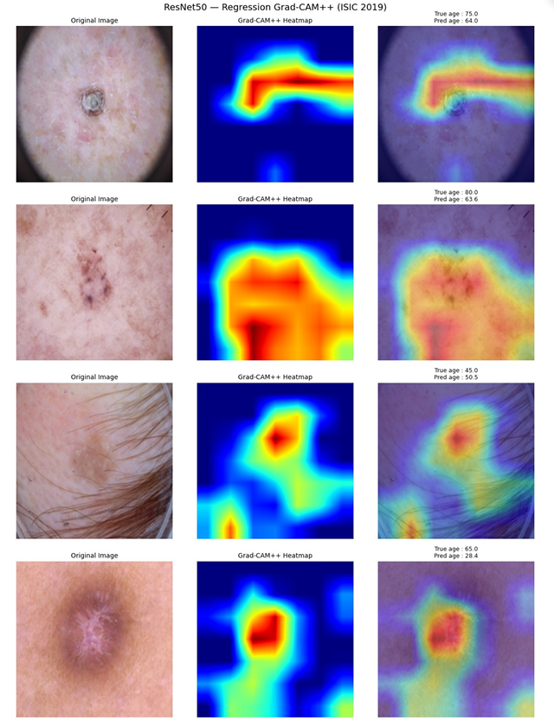
Evaluating VGG16 and ResNet50 for Simultaneous
Skin Lesion Diagnosis and Age Estimation
AIU
Mostofa Seum (23-50299-1), Md. Sakib Hasan (23-50316-1), Emon Biswas (23-50174-1)
Department of Computer Science, American International University-Bangladesh (AIUB), Dhaka, Bangladesh
{23-50299-1@student.aiub.edu, 23-50316-1@student.aiub.edu, 23-50174-1@student.aiub.edu}
Introduction
Results: Classification
Abstract
Skin cancer represents a significant and growing public health challenge worldwide. Clinical evidence consistently demonstrates that early and accurate detection substantially improves patient treatment outcomes. Dermatoscopy-based imaging, combined with artificial intelligence, has shown strong potential for automated analysis of skin lesions. While prior work has predominantly addressed lesion classification in isolation, patient metadata such as age carries independent clinical relevance. This project investigates whether a single convolutional neural network can be trained to perform both tasks concurrently: Classify dermoscopic images into one of eight lesion diagnostic categories
Estimate patient age directly from the dermoscopic image
Experiments were conducted on the
ISIC 2019 dataset (25,331 labeled images, 8 categories) using VGG16 and ResNet50 under identical experimental conditions.
Model | Accuracy | Macro F1 | Best Val F1
VGG16 | 65.57% | 0.4977 | 0.5200
ResNet50 | 68.82% | 0.5423 | 0.5141
This project explores how well deep learning models handle two medical imaging tasks simultaneously: identifying skin lesion types and estimating patient age. Using the ISIC 2019 dataset (25,331 dermoscopic images, 8 categories), VGG16 and ResNet50 were trained for classification and regression. Data augmentation, class weighting, and leak-proof data splitting were applied. Grad-CAM and Grad-CAM++ heatmaps provide visual interpretability. ResNet50 outperformed VGG16 on both tasks (68.82% accuracy; 10.34 yr MAE), demonstrating CNNs can support dual medical tasks efficiently.
Table I. Classification Results on Test Set
Conclusion
This project demonstrates that a single CNN can successfully perform dual medical tasks on dermoscopic images. Key findings: ResNet50 Wins Both Tasks: 68.82% accuracy and 0.5423 Macro F1 for classification; 10.34 yr MAE and R²=0.3736 for age regression — outperforming VGG16 in all metrics. Grad-CAM Validates Focus: Heatmaps confirm classification models focus on lesion regions. Regression attention is more diffuse — matching the difficulty of image-only age estimation. Efficiency Matters: ResNet50 achieves better results with 40% fewer parameters than VGG16, making it more viable for real-world deployment. Limitations: Class imbalance, image-only input, and limited architectures tested. Future work should incorporate clinical metadata (sex, location), test EfficientNet and vision transformers, and build true multi-task networks.
Fig 2. ResNet50 outperforms VGG16 on both accuracy and Macro F1.
Methods
Results: Age Regression
DATASET & PREPROCESSING
Model | MAE (yrs) | RMSE (yrs) | R²
VGG16 | 10.914 | 14.047 | 0.3054
ResNet50 | 10.337 | 13.340 | 0.3736
Images resized to 224×224px, normalized (ImageNet stats). Training: random flips, ±15° rotation, brightness/contrast jitter. 437 records with missing age removed → 24,894 samples. Split: Train 18,288 (73%) | Val 4,586 (18%) | Test 2,457 (10%) — lesion-level grouping prevents data leakage.
Table II. Age Regression Results on Test Set
MODEL ARCHITECTURE
VGG16: Deep architecture with stacked small convolutional filters (40.7M params). ResNet50: Modern residual design with skip connections (24.6M params). Both pretrained on ImageNet; early layers frozen, later layers fine-tuned.
68.82%
ResNet50
Accuracy
10.34
MAE
(years)
24.6M
ResNet50
Params
TRAINING SETTINGS
Optimizer: AdamW (lr = 1×10⁻⁴) | Batch: 32 | Epochs: 10 Classification loss: Weighted cross-entropy (handles class imbalance) Regression loss: MSE on normalized age targets (μ=54.66, σ=17.86 yrs)
Fig 3. ResNet50 achieves lower MAE and RMSE for age prediction.
Experiments were conducted on the
ISIC 2019 dataset (25,331 labeled images, 8 categories) using VGG16 and ResNet50 under identical experimental conditions.
Model Efficiency
References
ResNet50 uses ~24.6M parameters vs VGG16's ~40.7M, while achieving better performance on both tasks. This makes ResNet50 faster to run and more suitable for real-world clinical deployment.
[1] ISIC 2019 Challenge Dataset. International Skin Imaging Collaboration, 2019. https://challenge.isic-archive.com [2] P. Tschandl et al., "The HAM10000 dataset, a large collection of multi-source dermatoscopic images," Scientific Data, vol. 5, p. 180161, 2018. [3] K. Simonyan & A. Zisserman, "Very deep convolutional networks for large-scale image recognition," arXiv:1409.1556, 2014. [4] K. He et al., "Deep residual learning for image recognition," CVPR, 2016, pp. 770–778. [5] R. R. Selvaraju et al., "Grad-CAM: Visual explanations from deep networks," IJCV, vol. 128, pp. 336–359, 2020. [6] A. Chattopadhay et al., "Grad-CAM++: Generalized gradient-based visual explanations," WACV, 2018, pp. 839–847.
Data Analysis
The ISIC 2019 dataset is highly imbalanced. Melanocytic Nevi (NV) dominates with ~12,875 images, while rare classes like Vascular Lesions (VASC) and Squamous Cell Carcinoma (SCC) have only ~263 and ~628 images respectively.
Fig 4. ResNet50 is significantly lighter with fewer parameters.
Visual Explanations (Grad-CAM++)
Acknowledgement
Red/yellow = high attention. Classification focuses on lesions; regression attention is more diffuse.
The authors thank the International Skin Imaging Collaboration (ISIC) for providing the publicly available ISIC 2019 dermoscopic image dataset. We also acknowledge the Department of Computer Science, AIUB, for academic support and resources. This project was conducted as part of the CVPR course requirement.
VGG16 — Classification
ResNet50 — Classification
Index Terms
Skin Lesion Classification • Age Regression • ISIC 2019 • VGG16 • ResNet50 • Grad-CAM • Grad-CAM++ • Medical Imaging • Deep Learning • CNN • Class Imbalance
Fig 1. NV class dominates, creating class imbalance.
VGG16 — Age Regression
ResNet50 — Age Regression
Department of Computer Science, Faculty of Science and Technology | American International University-Bangladesh (AIUB)

